Slide 1

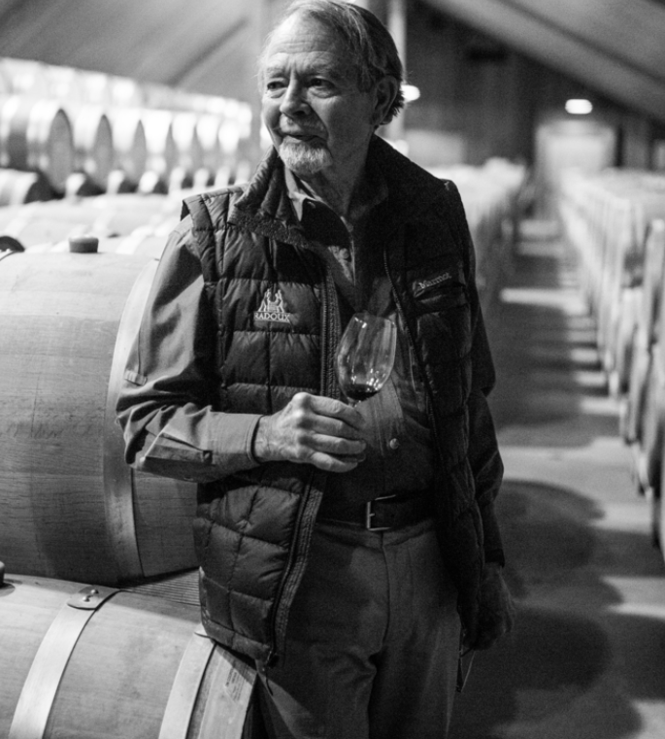

Capstone California
Californian Wine Training Program

Slide 2


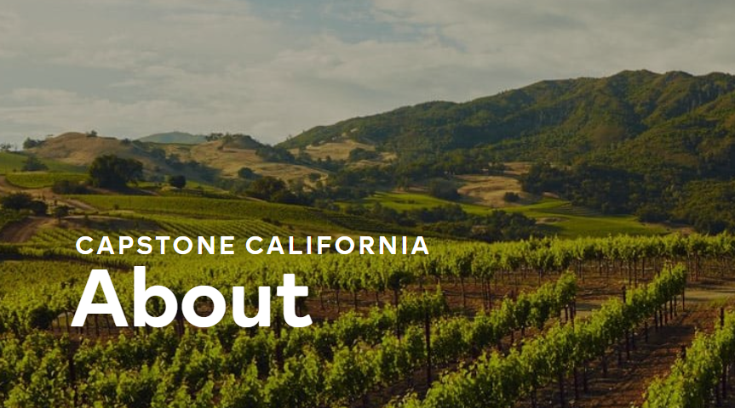

ABOUT
  Since 1934, Wine Institute has supported California’s wineries. Developed by California Wines, this website offers up-to-date resources on California wine, featuring contributions from 4,200 wineries and top industry professionals. Capstone California provides four levels of structured study for both consumers and professionals.

Slide 3
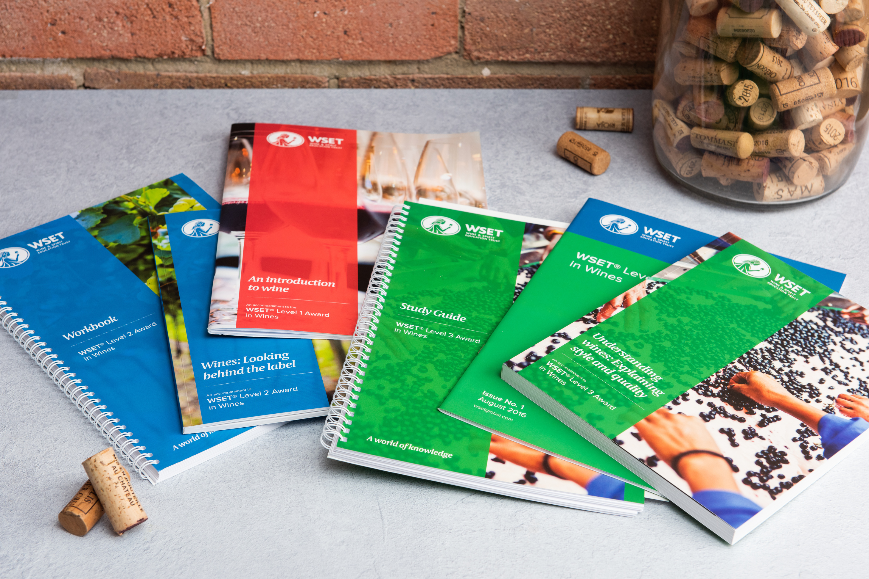
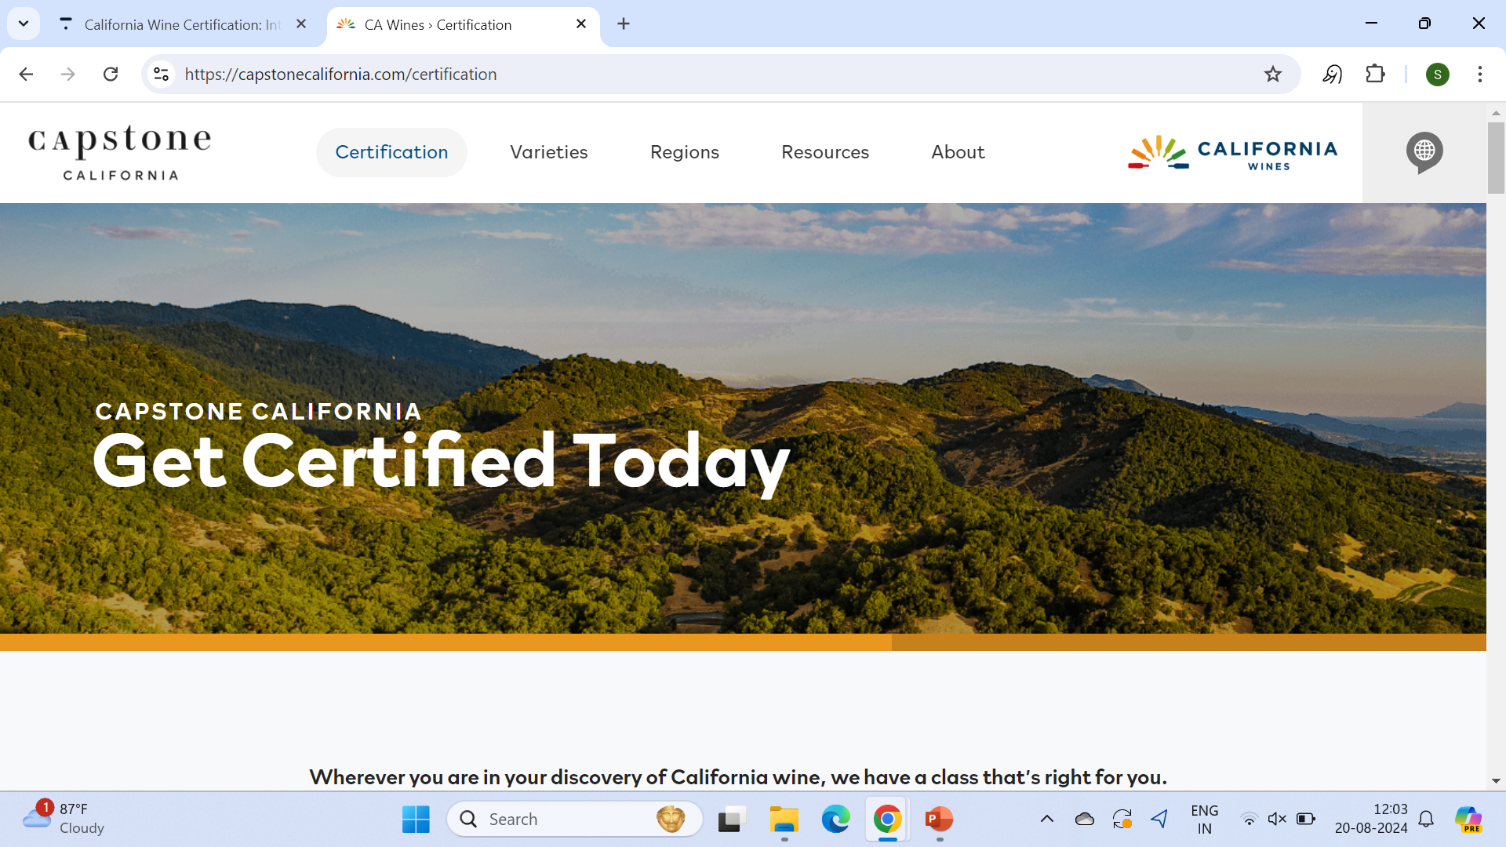
FRAMEWORK
STRUCTURE
Duration : 6 hours
Curriculum:
History: Mission era to modern times
Geography: Impact of Pacific Ocean and mountains on viticulture
Viticulture: Grape-growing practices, key grape varieties
AVA System: Napa Valley, Sonoma County, Santa Barbara County
Wineries: Ridge Vineyards, Frog’s Leap, Robert Mondavi
Statistics: California’s global wine production, consumption, exports

Slide 4
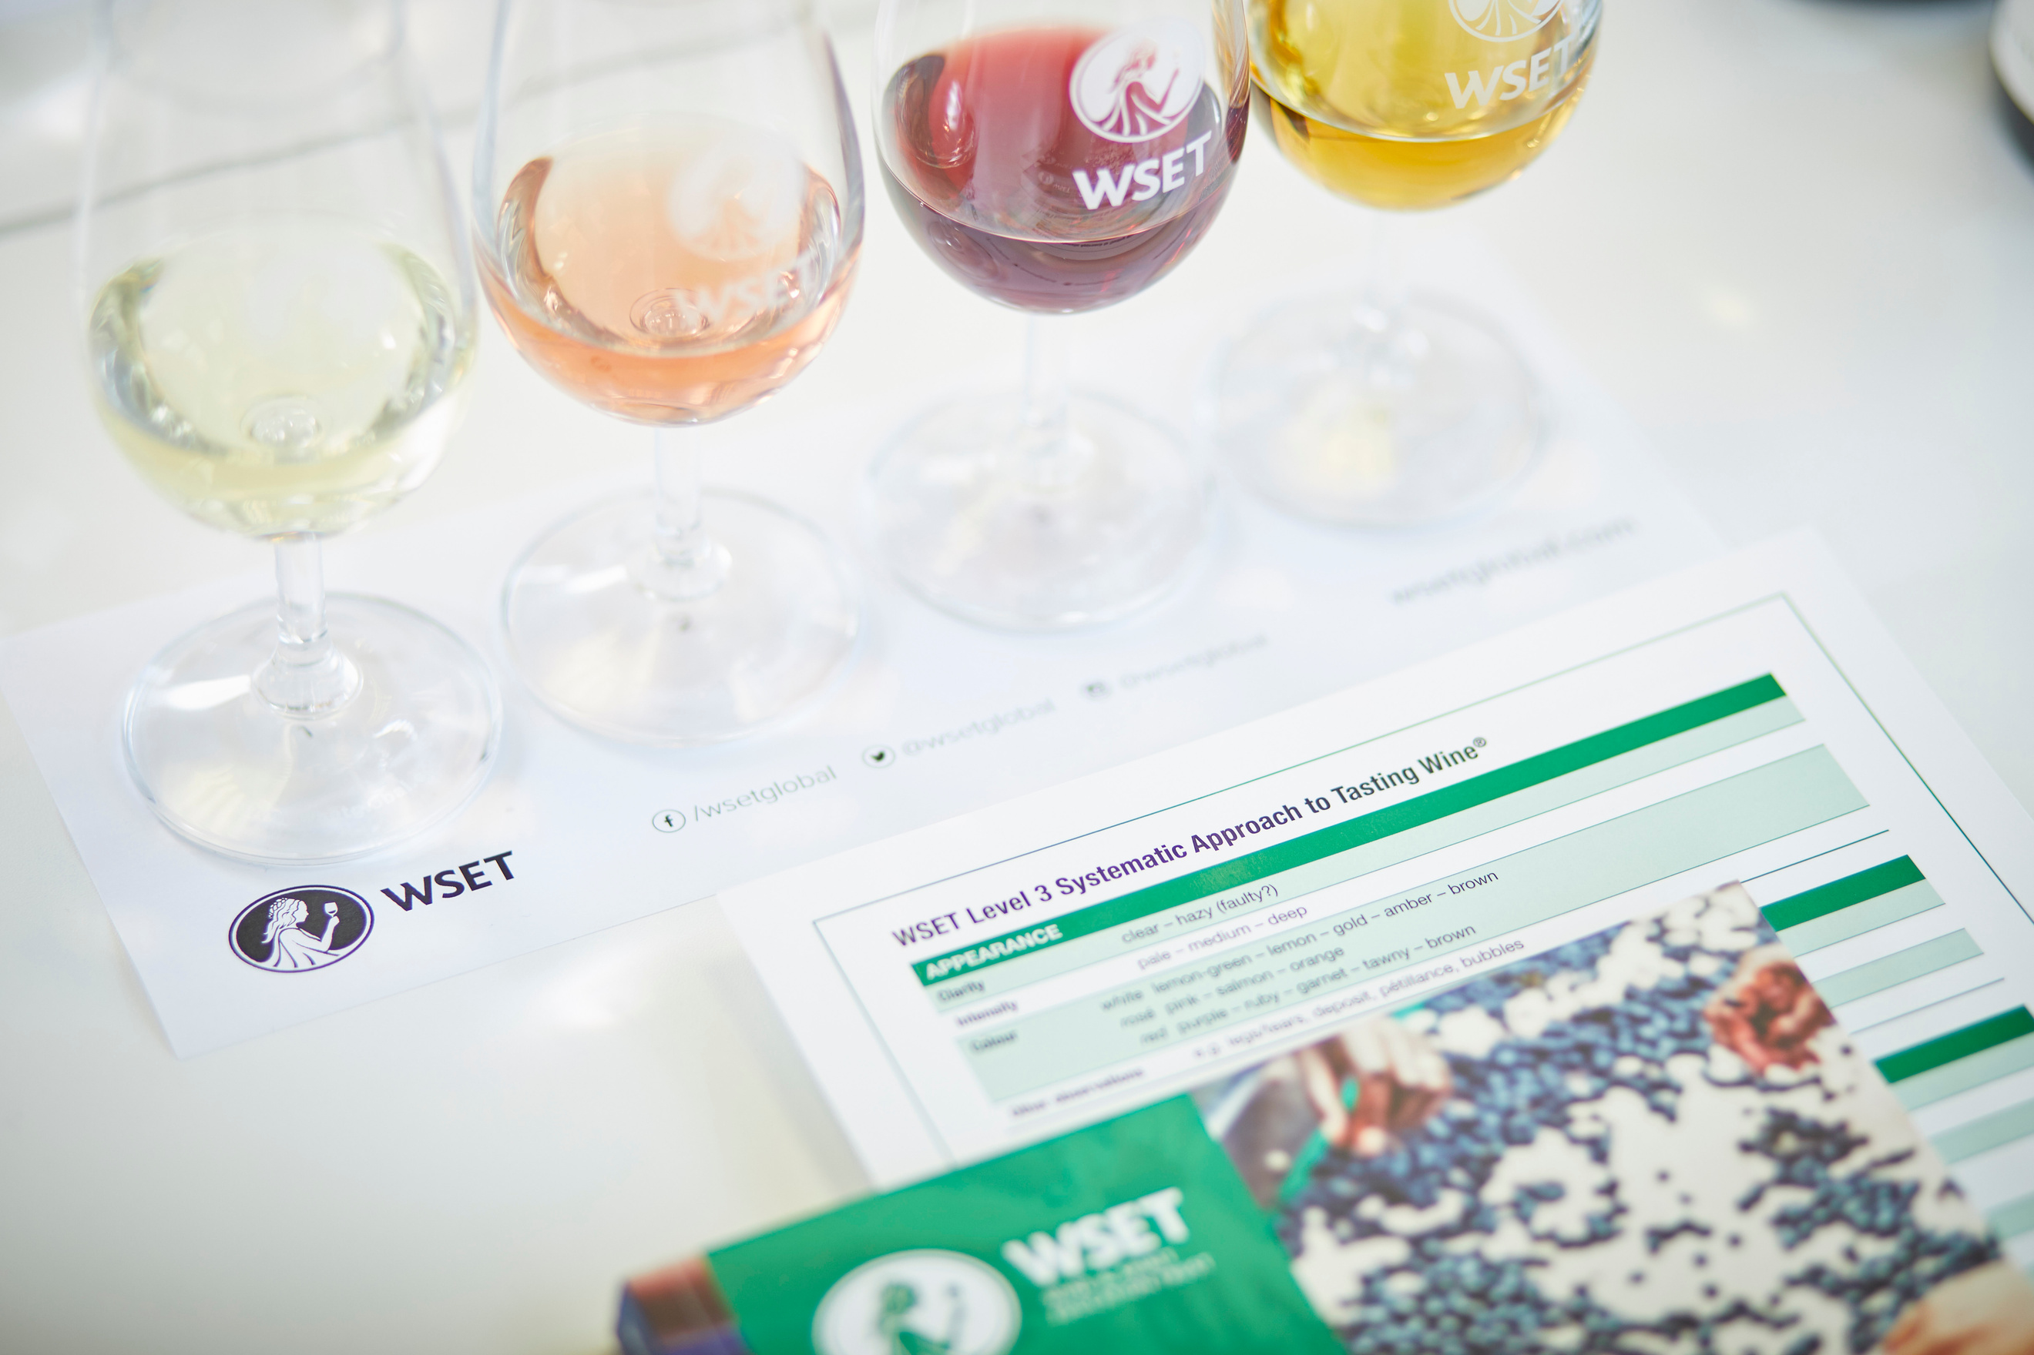

TULLEEHO
  Established in 2000, Tulleeho is a provider of beverage education, training and consulting services in South Asia and South East Asia. Headquartered in Delhi, with offices in Mumbai and Bangalore.
  Our clients include multi-national and Indian beverage companies, hotel chains and independent bars and restaurants.
  We run training programs for beverage professionals, bar professionals, drinks enthusiasts, beverage retail and hotel management students and faculty
  The Tulleeho Book of Cocktails was published in 2011. Our website www.tulleeho.com is a premier destination for those who savour drink and the drinking experience.
  We also run specialized wines, spirits and beer education programs, with affiliations to global certification programs
  Our consulting services include blend / product research, bar menu design and market entry assistance

Slide 5


COMMERCIALS
(Free of Cost)

Slide 6

THANK YOU

